Slide 1

Crop Production Analysis in India
India's agricultural sector is a vital part of the country's economy, contributing around 17-18% to its Gross Domestic Product (GDP) and providing employment to over 50% of the population. This comprehensive analysis delves into the diverse crop production landscape of India, highlighting key insights and metrics that influence crop yields and productivity.

Slide 2
Economic Contribution and Diversity
Economic Contribution
Diverse Crop Production
Green Revolution Impact
Agriculture contributes around 17-18% to India's GDP and is a primary source of livelihood for over 50% of the population.
India is a leading global producer of crops such as rice, wheat, pulses, sugarcane, cotton, and spices, taking advantage of its diverse agro-climatic zones.
The Green Revolution in the 1960s-70s significantly increased food grain production, with wheat production rising from 10 million tonnes to over 110 million tonnes.

Slide 3
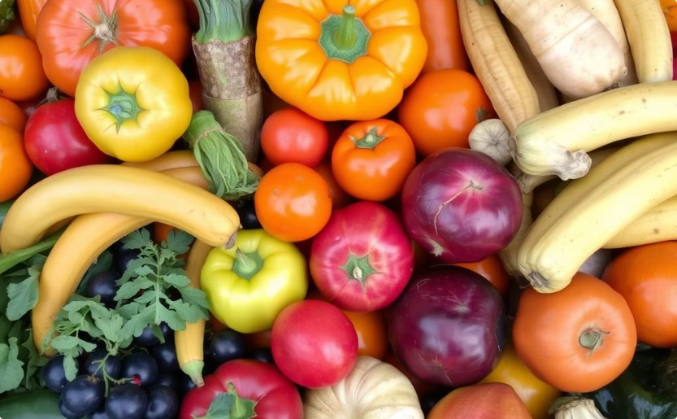

Horticulture, Dairy, and Exports
Horticulture and Dairy
Agricultural Exports
India is a leading producer of fruits, vegetables, and milk, with annual production exceeding 320 million tonnes for horticulture and 210 million tonnes for dairy.
India's agricultural exports contribute significantly to its foreign exchange, valued at around $50 billion in 2022-2023, with major items including rice, spices, sugar, and tea.

Slide 4
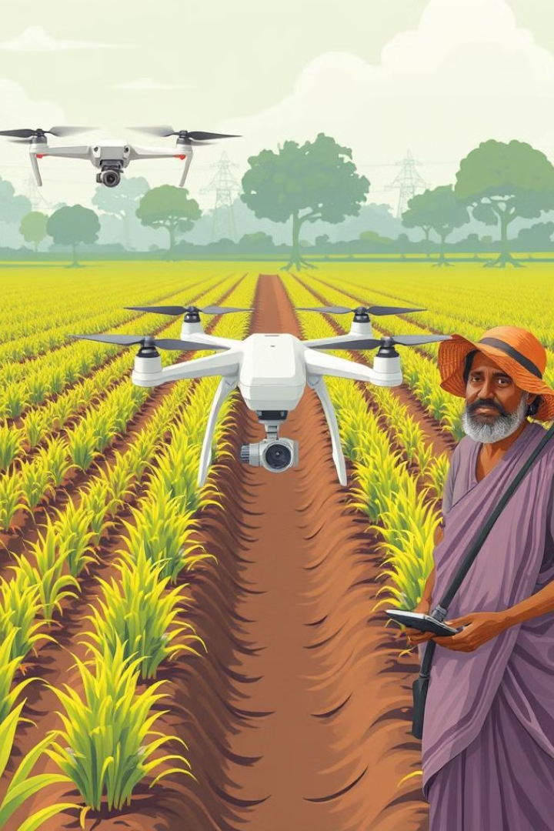
Government Initiatives and Challenges
1
Government Initiatives
The government has launched programs like PMFBY (crop insurance), PM-KISAN (income support), and e-NAM (digital agricultural markets) to support farmers and improve productivity.
2
Challenges
India faces challenges such as fragmented land holdings, water scarcity, and soil degradation, which the government is addressing through sustainable farming practices and technology adoption.
3
Sustainability and Modernization
Efforts are underway to promote organic agriculture, precision farming, and the use of renewable energy in agriculture to ensure long-term sustainability.

Slide 5
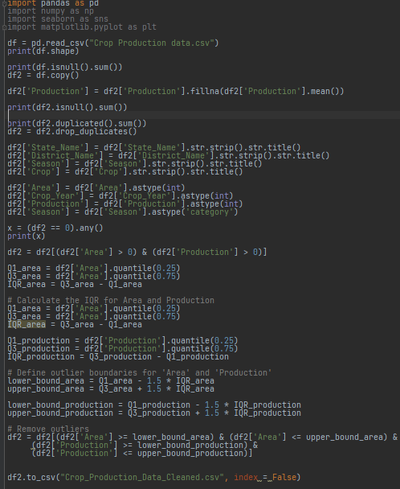
Data Collection and Analysis
1
Data Collection
The dataset was obtained from the unified mentor portal as an Excel workbook, containing 246,092 rows of data with information on crop production across India's states and districts from 1997 to 2015.
2
Data Cleaning and Analysis
The data was cleaned and analyzed using tools like Pandas, Seaborn, and Matplotlib, with steps including filling missing values, removing duplicates, and identifying outliers.
3
Data Visualization
The cleaned data was then visualized using Power BI, creating various charts, maps, and dashboards to uncover insights and trends in India's crop production.

Slide 6
Key Insights and Trends
Crop Diversity
Regional Variations
India's diverse agro-climatic zones support the cultivation of a wide range of crops, from cereals and pulses to fruits, vegetables, and spices, making it a global leader in several agricultural commodities.
The analysis revealed significant variations in crop production across different states and districts, highlighting the need for targeted interventions and policies to address regional disparities.
Productivity Trends
Export Potential
The data showed both positive and negative trends in crop yields over the years, underscoring the importance of factors like weather, technology adoption, and government support in influencing agricultural productivity.
India's strong position as a major producer of various crops, coupled with its growing agricultural exports, suggests significant untapped potential to further boost the country's global market share and foreign exchange earnings.

Slide 7




Informing Decision-Making
Data-Driven Insights
The comprehensive analysis of crop production data provides valuable insights that can inform decision-making at the policy, industry, and farm levels.
Targeted Interventions
The insights can help identify areas for targeted interventions, such as improving infrastructure, promoting technology adoption, and addressing regional disparities in productivity.
Sustainable Growth
By leveraging the data-driven insights, stakeholders can develop strategies to enhance agricultural productivity, promote sustainable farming practices, and strengthen India's position in the global agricultural market.

Slide 8

Insights Generated
Comprehensive analysis of crop production, area sown, and regional trends in India.

Slide 9
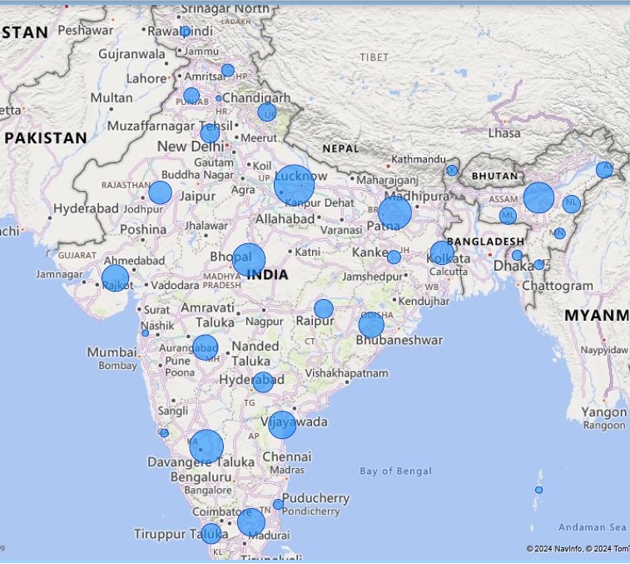
Crop Production Overview
Total Crop Production
238M units across all regions
Total Area Sown
328M units across all regions
Total Districts
646 districts across India
Total Crops Grown
105 crops cultivated in India

Slide 10
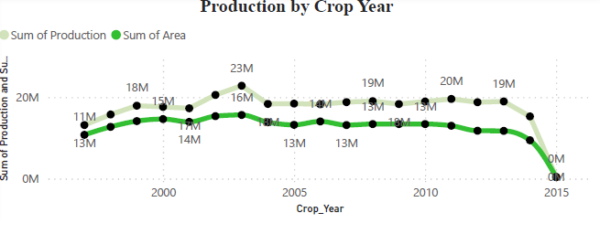
Yearly Trends
1
Highest Production
3
Highest Area Sown
Year 2003
Year 2003
2
Lowest Production
4
Lowest Area Sown
Year 2015
Year 2015

Slide 11
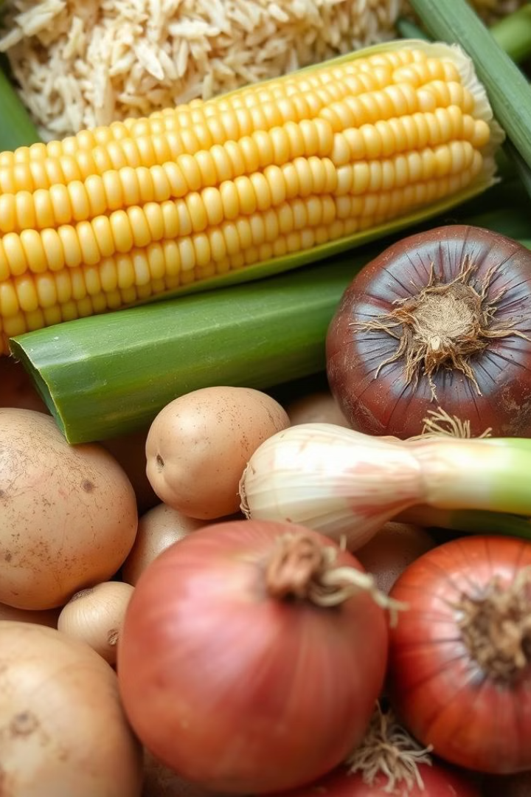





Crops, States & District With Highest
Production Volume
Top Crops
Top District
Maize
Prakasam, AP
Visakapatanam, AP
Rice
Chitradurga, KR
West Garo Hills, Meghalaya
Potato
Spsr Nellore, AP
Onion
Top Regions
Sugarcane
Uttar Pradesh
Karnataka
Bihar
Madhya Pradesh
Assam

Slide 12

Seasonal Trends
1
Highest Production
Kharif Season
2
Lowest Production
Winter Season
3
Highest Area Sown
Kharif Season
4
Lowest Area Sown
Winter Season

Slide 13

Regional Crop Production Patterns
1
Highest Producing Region
2
Lowest Producing Region
Uttar Pradesh is the region with the highest crop production in India.
Chandigarh is the region with the lowest crop production in India.
3
Seasonal Variations
4
Top Producing States
The Kharif season witnesses the highest crop production, while the Winter season has the lowest.
The top 5 states with the highest crop production are Uttar Pradesh, Karnataka, Bihar, Madhya Pradesh, and Assam.

Slide 14
Crop-Specific Insights
Maize
Rice
Potato
Maize is the highest produced crop in India, with Bihar being the state with the highest production and Banka district being the top producing region. Maize is grown in 542 districts across the country.
Rice is the second highest produced crop in India, with Assam being the state with the highest production. Rice is extensively grown in the North-Eastern region of the country.
Potato is the third highest produced crop in India, with Madhya Pradesh being the state with the highest production. Potato is a major crop in the North-Eastern region as well.
Onion
Sugarcane
Onion is the fourth highest produced crop in India, with Uttar Pradesh being the state with the highest production. Onion is a significant crop in the Central and Western regions of the country.
Sugarcane is the fifth highest produced crop in India, with Madhya Pradesh being the state with the highest production. Sugarcane is a major crop in the Southern and Central regions of the country.

Slide 15
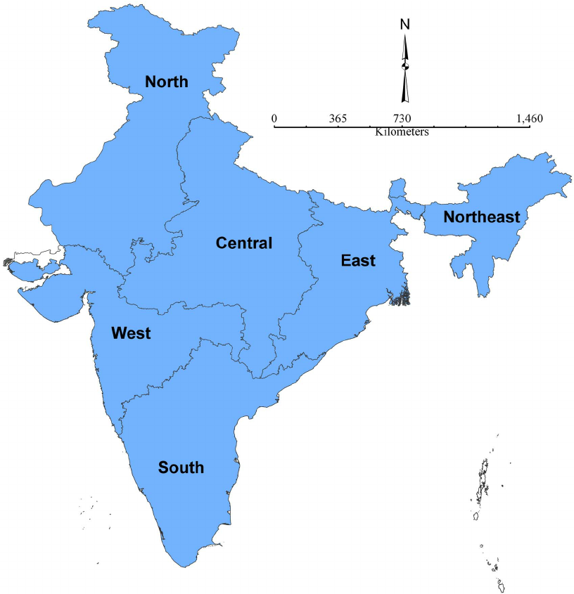
Regional Crop Production Patterns
Highest Produced Crop
Production Trends
Maize is grown extensively all over India with Bihar being the highest produced state & Banka being the most maize producing district and almost 542 district’s grow maize all over India.
The year with the highest crop production was 2003, while the year with the lowest production was 2015. Similarly, the year with the highest area sown was 2003, and the lowest was 2015.
South
North
West
Rice, maize, groundnut, onion, banana
Potato, barley, rice, maize, rapeseed
Groundnut, maize, rice, jowar, sugarcane
East
North East
Central
Maize, Rice, Sugarcane, Potato, Onion
Rice, Potato, Sugarcane, Maize, banana
Potato, Onion, Maize, Sugarcane, Jowar.

Slide 16




Seasonal Crop Production
Kharif Season
Rabi Season
Winter Season
The Kharif season witnesses the highest crop production in India, with Maize, Rice, and Sugarcane being the top crops.
The Rabi season is the second highest in terms of crop production, with Barley, Rice, and Rapeseed & Mustard being the top crops.
The Winter season has the lowest crop production in India, with Odisha, Kerala, and the North-Eastern states being the primary regions of cultivation.

Slide 17





Recommendations
Implement Advanced Technologies
Implement advanced AI and IoT technologies in the agricultural sector to enhance production and optimize field-level management.
Farmer Capacity Building
Conduct workshops and training programs to help farmers utilize scientific instruments and adopt sustainable farming practices.
Market Research and Insights
Regularly conduct market research to identify and address emerging challenges, and help farmers stay informed about market trends.
Policy Support and Outreach
Ensure that all farmers are aware of and have access to government policies and support programs to enhance their productivity and income.

Slide 18
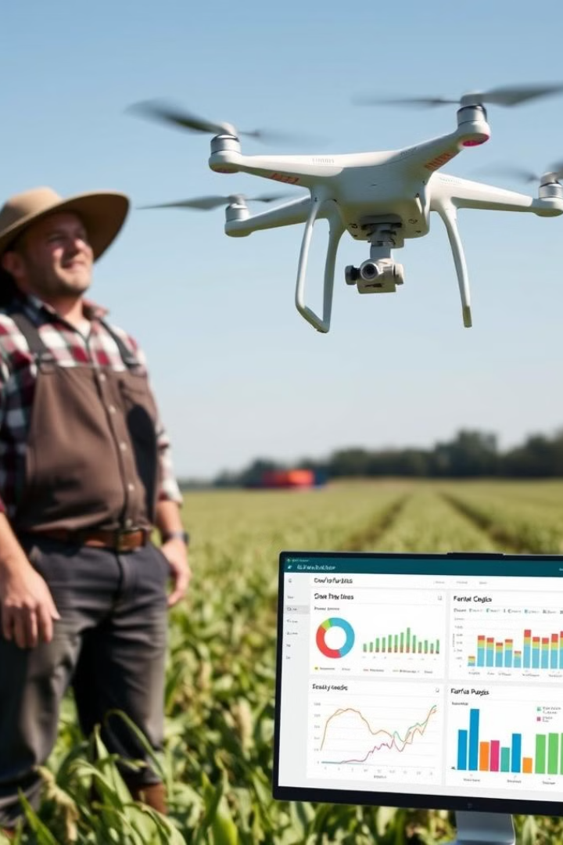
Recommendations
1
Conduct Workshops on Soil, Water, Weather.
To equip farmers with the knowledge of science
2
Promote Organic Farming
Sustainable practices for the future
3
Improve Supply Chain
Minimize crop waste and optimize distribution
4
Leverage GPS & Data Analytics
Optimize field-level management

Slide 19
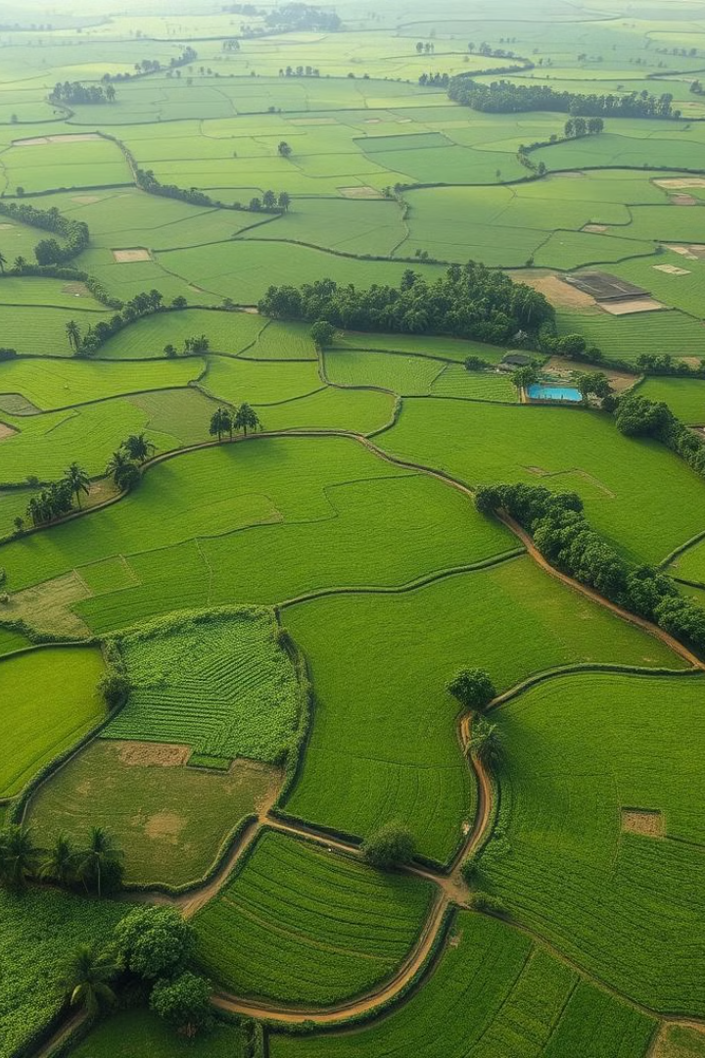
Conclusion
This comprehensive analysis of crop production in India has uncovered valuable insights and trends that can inform decision-making and guide the future development of the country's agricultural sector. By leveraging data-driven insights, stakeholders can work towards enhancing productivity, promoting sustainability, and strengthening India's position as a global agricultural powerhouse.

